Slide 1
Continuous Integration and Continuous Delivery (CI/CD) Pipeline
PPSD PRESENTATION
Group 4

Slide 2
AGENDA
Introduction
What is it?
Usage & Advantages
Techniques
DevOps
What is it?
Other Traditional Models
Role of DevOps in CI/CD
Phases & Tools
Continuous Integration
Overview
Processes
Tools: Get Starting with Jenkins
Continuous Delivery
Overview
Process & Pipeline
Continuous Delivery and Development
Conclusion

Slide 3
INTRODUCTION
What is CI/CD Pipeline

Slide 4
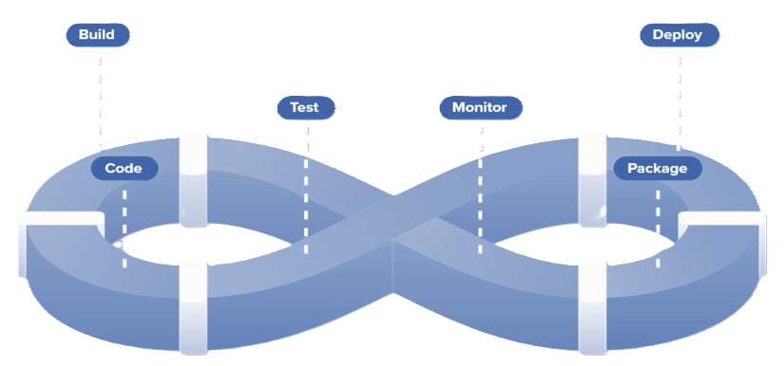
INTRODUCTION
The CI/CD (Continuous Integration / Continuous Delivery) pipeline is a set of automated processes that allow developers to efficiently and continuously deliver code changes from development to production

Slide 5
USAGE
Building
Testing
Compiling source code and dependencies into executable binaries or artifacts.
Verifies the functionality, performance, and reliability of the software through automated tests.
CI/CD pipelines are widely used in modern software development to automate and streamline the process of building, testing, and deploying software applications.
Improving
Deploying
Addresses any issues or bugs identified during testing, ensuring the software meets quality standards.
Releasing the tested and fixed software to production or staging environments for end-user access.

Slide 6
ADVANTAGES
Advantages include faster release cycles, improved code quality, reduced risk of errors, and enhanced collaboration between development and operations teams.
Faster Release
Collaboration
Improve Quality
deliver new features and updates to users more frequently, staying competitive in rapidly evolving markets.
fosters teamwork and communication between developers and operations teams.
software works as expected, with fewer bugs and errors.

Slide 7
DevOps & CI/CD
Overview

Slide 8
Structured Approach
Rigidity
Provides a clear and structured approach to software development
Less adaptable to changes in requirements or unforeseen issues, leading to potential delays and increased costs.
Waterfall
Waterfall is traditional approach of software development where everything happens step by step.
Series includes Requirements Gathering, Design, Development, Testing, Maintenance
Its less flexible and costly.
Predictable Projects
It is commonly used in projects with a clear understanding of scope and limited uncertainty.

Slide 9
Flexibility
Dynamic Projects
Enables teams to respond quickly to customer feedback and market changes.
Commonly used in software development projects where innovation, responsiveness, and customer satisfaction are priorities.
Agile
Programmers creates prototypes to understand client’s requirements
The entire process is break down into small actions called sprints which is submitted every 2 weeks.
Fails when developers and operation team works in silos
Communication
Iterative development cycles for rapid and adaptable delivery of software solutions through collaborative teamwork and continuous improvement.

Slide 10
DevOps Phases
DevOps is typically broken down into eight distinguished phases as an operational model. The phases operate in a continuous loop, with each phase providing value to the phase ahead of it
Phase 01
Phase 02
Phase 03
Phase 04
Plan
Code
Build
Test
Phase 08
Phase 07
Phase 06
Phase 05
Monitor
Operate
Deploy
Release

Slide 11
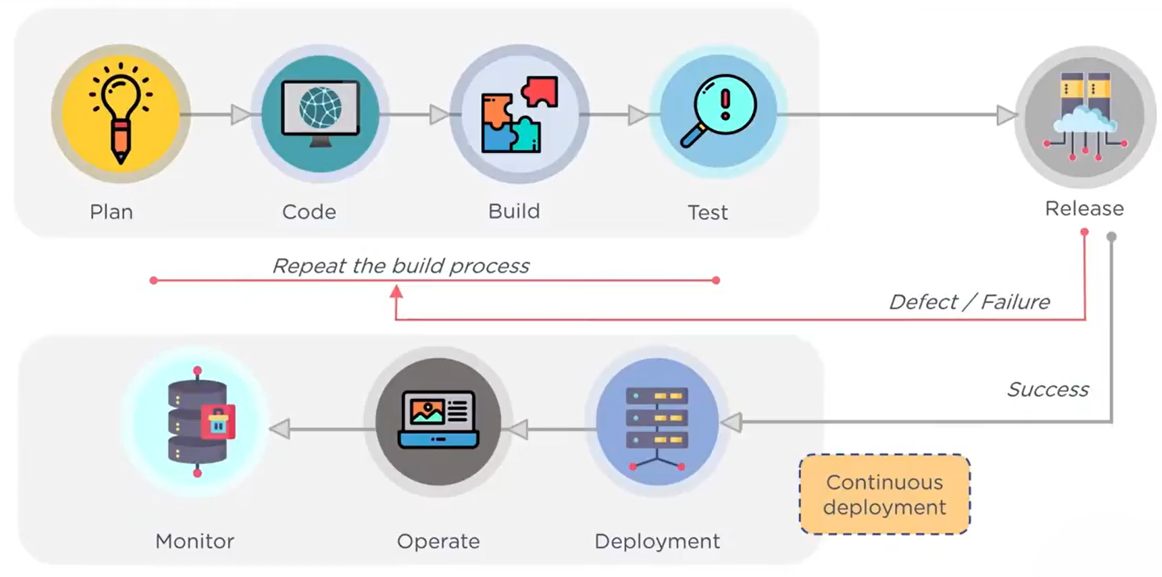
Role of DevOps in CI/CD

Slide 12
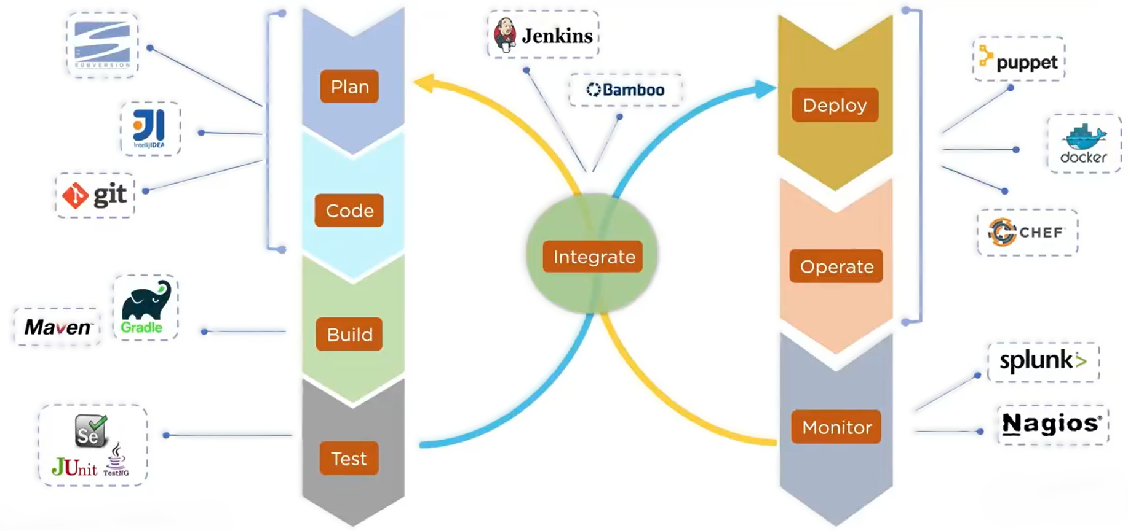
DevOps Tools

Slide 13
Continuous Integration & Delivery
Overview

Slide 14
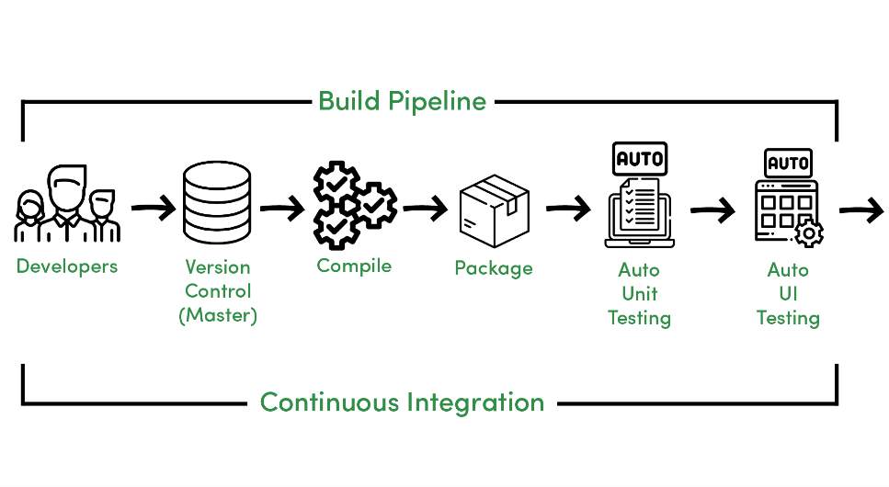
CI Phase
Continuous Integration is a development practice of code integration into a shared repository. Each integration is verified by an automated build and automated test.

Slide 15
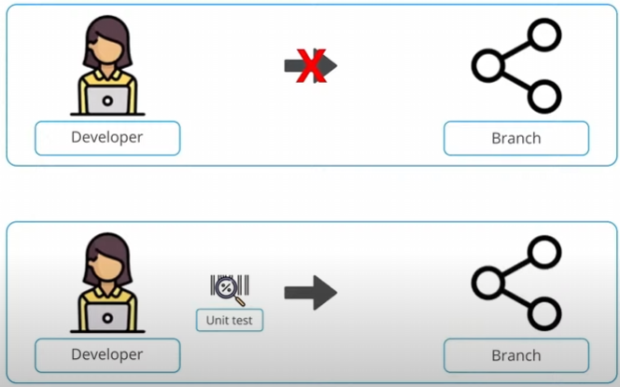
Continuous Integration

Slide 16
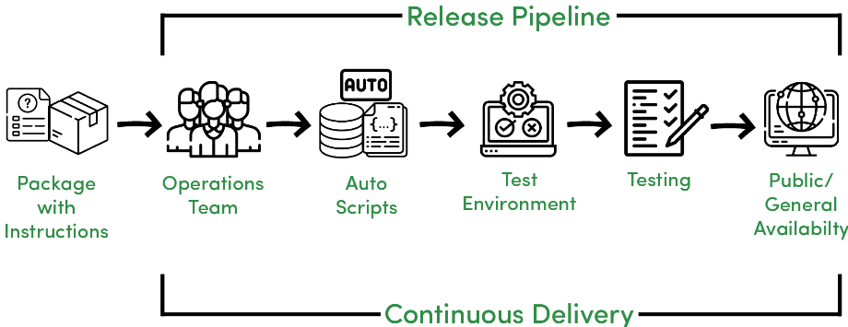
CD Phase
Continuous Delivery is a development practice of code which occurs after the integration phase.

Slide 17
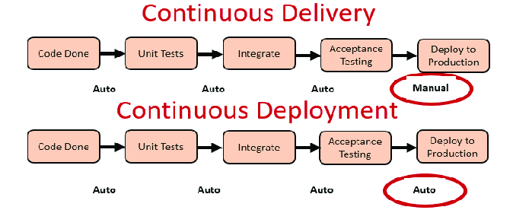
Continuous Delivery & Deployment

Slide 18
Sample CI/CD Pipeline
Demonstration of a sample CI/CD pipeline using tools

Slide 19
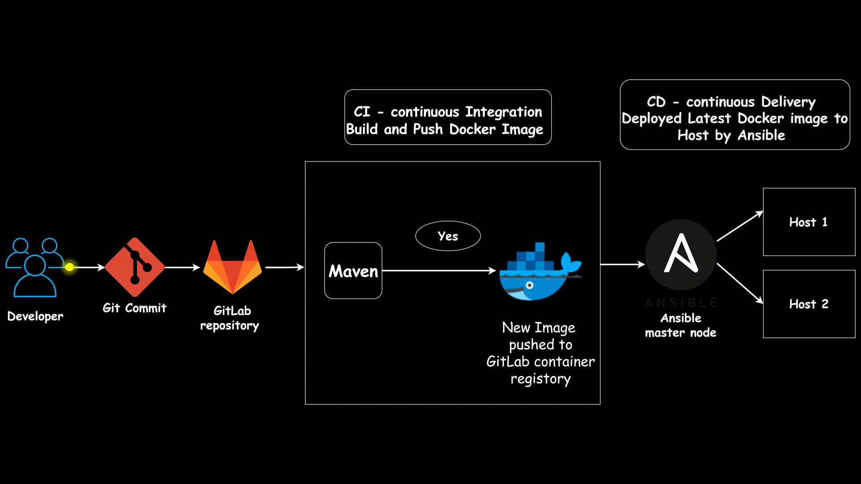
GitLab

Slide 20
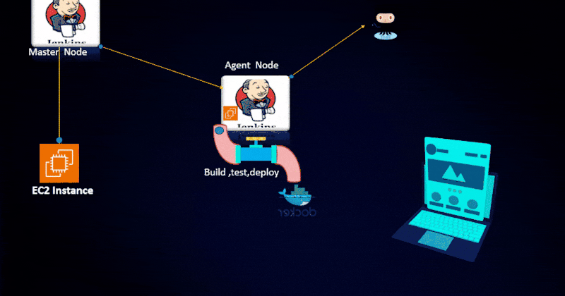
Jenkins

Slide 21
Conclusion
Finalization

Slide 22
Strengths
Improving Code Quality
Accelerating Delivery Cycles
Enabling Faster Feedback Loops

Slide 23
Percentage Chart
By leveraging CI/CD pipelines, organizations can achieve continuous improvement in code quality, delivery speed, and responsiveness to customer needs, ultimately driving business success and innovation
55%
45%
CI/CD pipelines can lead to significant improvements in delivery speed, with some companies reporting up to 90% reductions in deployment times.
CI/CD practices promote better code quality by automating code reviews, testing, and validation processes.

Slide 24
Numerical Stats
4 Million builds per day
50 Million per year
1 Thousand per day
Google
Amazon
Netflix
Utilizes CI/CD extensively for its wide range of products, including Google Search, Gmail, and Google Cloud Platform.
Emphasizes CI/CD practices for its cloud computing services and various online retail operations.
Relies heavily on CI/CD for its streaming platform, enabling rapid feature releases and updates.

Slide 25
THANKS
Group 4

